Slide 1
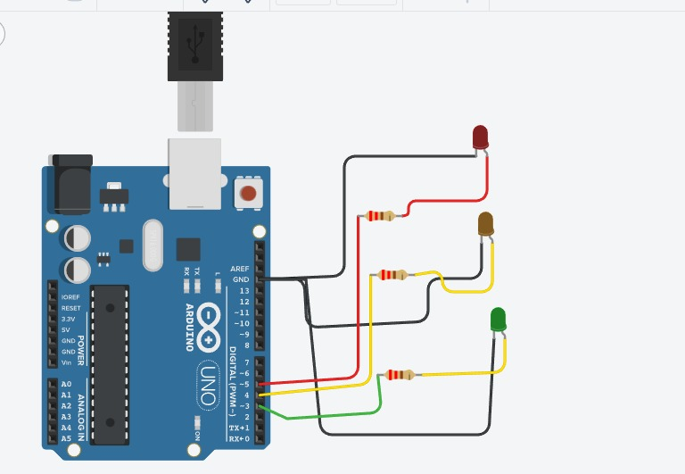
Traffic Light Using Arduino In Tinkercad
Traffic light circuit:

Slide 2
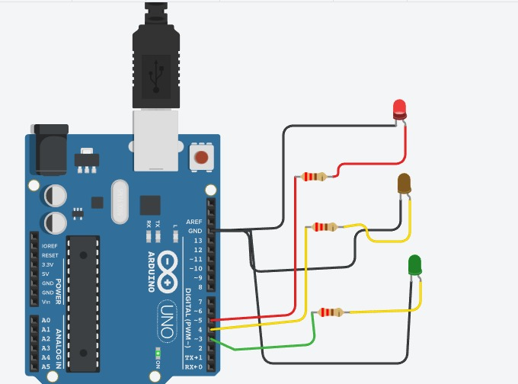
Red Light ON-A driver should stop

Slide 3
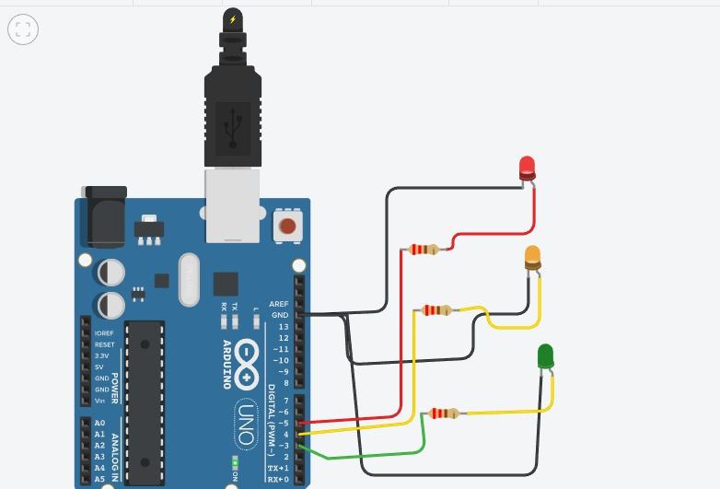
Yellow Light ON-A driver has to slow down and be ready to stop

Slide 4
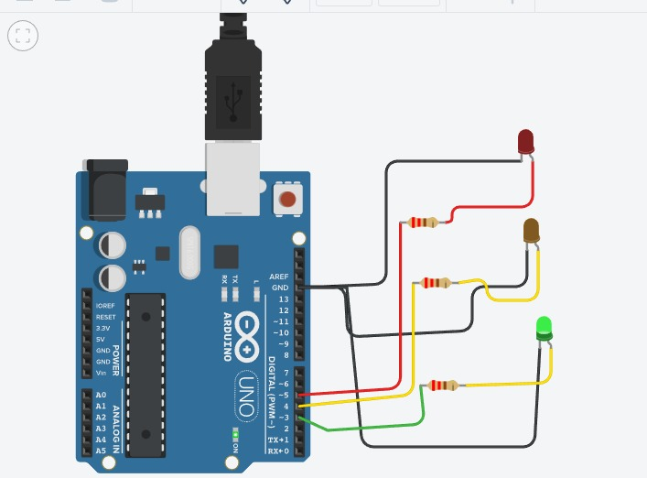
Green light ON-A driver can start driving or keep driving

Slide 5
Traffic light code:
int red = 5;
int yellow = 4;
int green = 3;
void setup()
{
pinMode(red, OUTPUT);
pinMode(yellow, OUTPUT);
pinMode(green, OUTPUT);
}
void loop()
{
changeLights();
delay(15000);
}

Slide 6
void changeLights()
{
// green off, yellow on for 3 seconds digitalWrite(green, LOW);
digitalWrite(yellow, HIGH);
delay(3000);
// turn off yellow, then turn red on for 5 seconds
digitalWrite(yellow, LOW);
digitalWrite(red, HIGH);
delay(5000);

Slide 7
// red and yellow on for 2 seconds (red is already on though)
digitalWrite(yellow, HIGH);
delay(2000);
// turn off red and yellow, then turn on green
digitalWrite(yellow, LOW);
digitalWrite(red, LOW);
digitalWrite(green, HIGH);
delay(3000);}

